Slide 1
Hall C Upgrade
SHMS
(& HMS)
Steven Lassiter
Paul Brindza, Eric Sun, Mike Fowler
Bert Metzger, Dan Young, Paulo Medeiros
Hall C User Group
Jefferson Lab
June 23, 2017

Slide 2
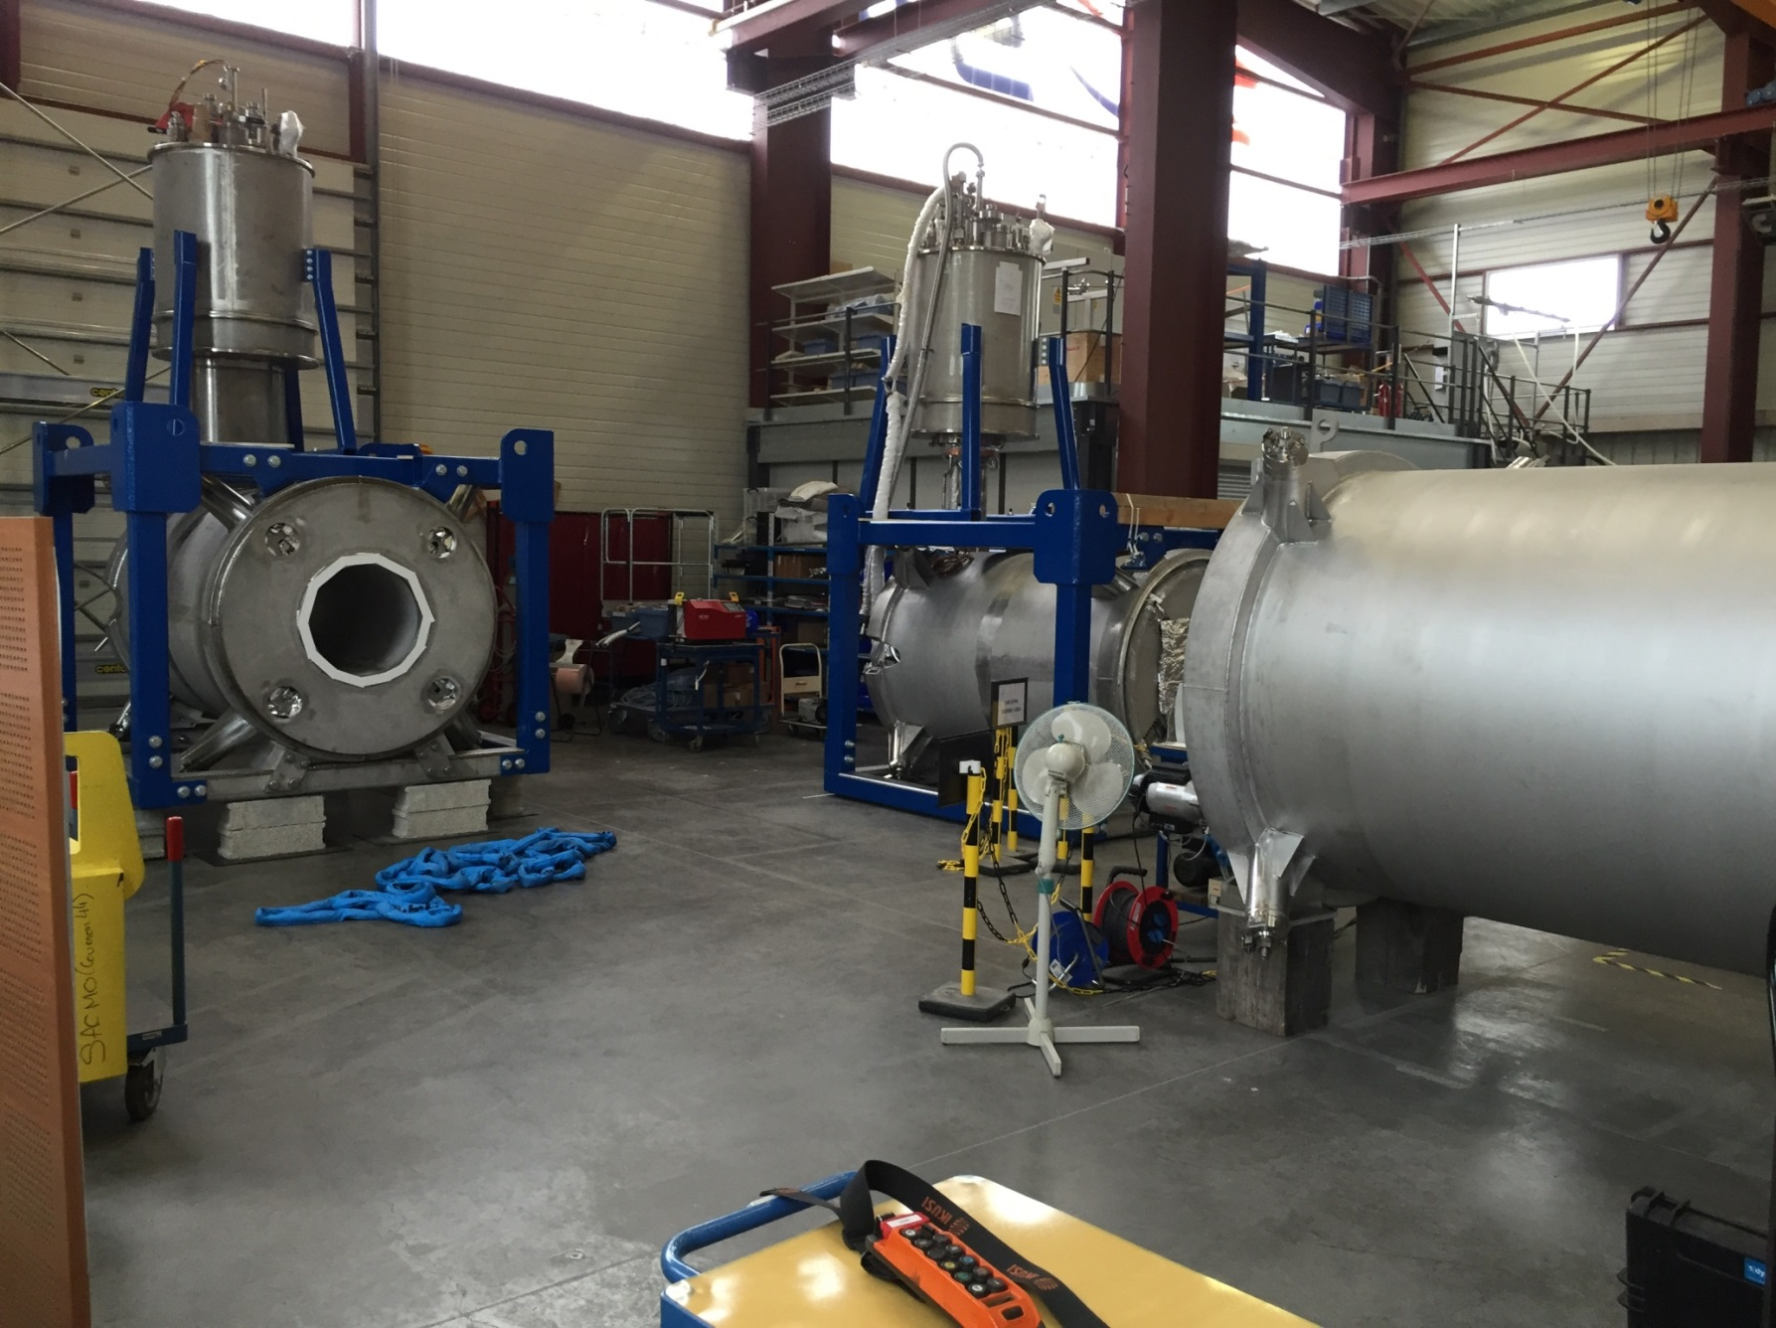
Magnets at Sigma Phi (July 2016)
Q3
Dipole
Q2

Slide 3
Hall-C D/Q2/Q3 Magnet Installation Timeline
Begin Dipole Chimney Installation
Q3 Cold at 4K and Full
Key Performance Parameter Run
All Magnets Powered Together
Dipole Arrives at Jefferson Lab
Q3 at 11 GeV/c Current
Q2 Arrives at Jefferson Lab
Q3 Arrives at Jefferson Lab
Dipole Chimney Completed
Dipole at 11 GeV/c Current
Sigmaphi Magnets ERR
Q2 Cold at 4K and Full
Q2 at 11 GeV/c Current
Dipole Cold at 4K and Full
Dipole Chimney Installation
Oct 2016
Nov 2016
Dec 2016
Jan 2017
Feb 2017
Mar2017

Slide 4
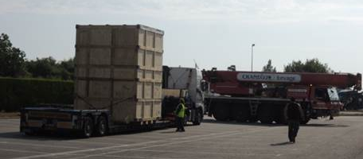
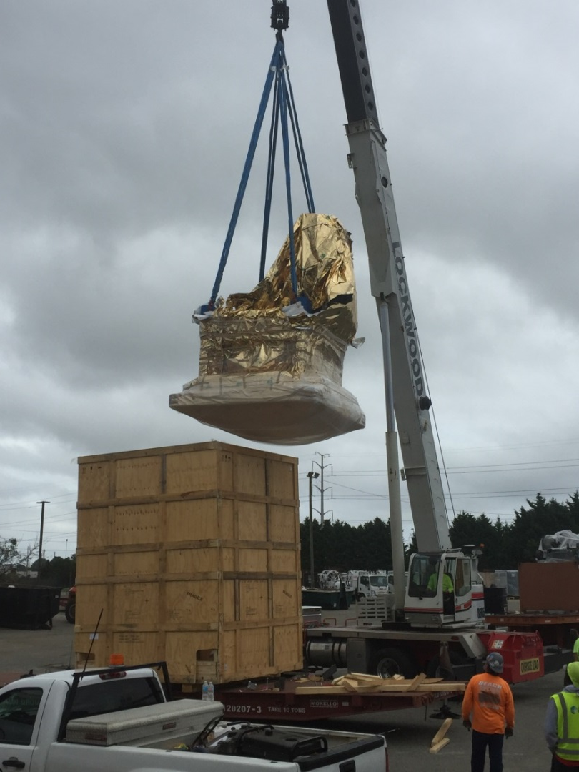
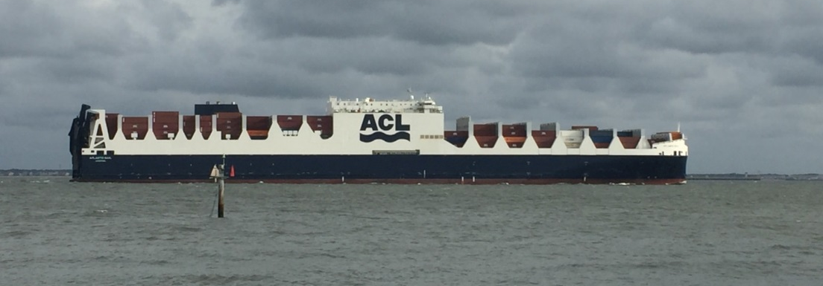
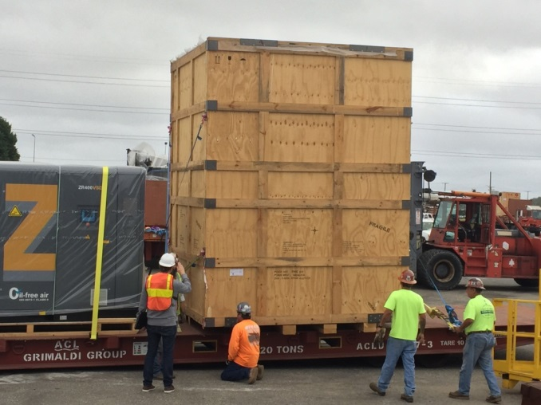
Q2’s journey from Sigma Phi to JLAB
Aug 26, 2016
Left Sigma Phi
Oct 5, 2016
Hampton Roads Va
Oct 6, 2016
Unloaded at Port Norfolk Va

Slide 5
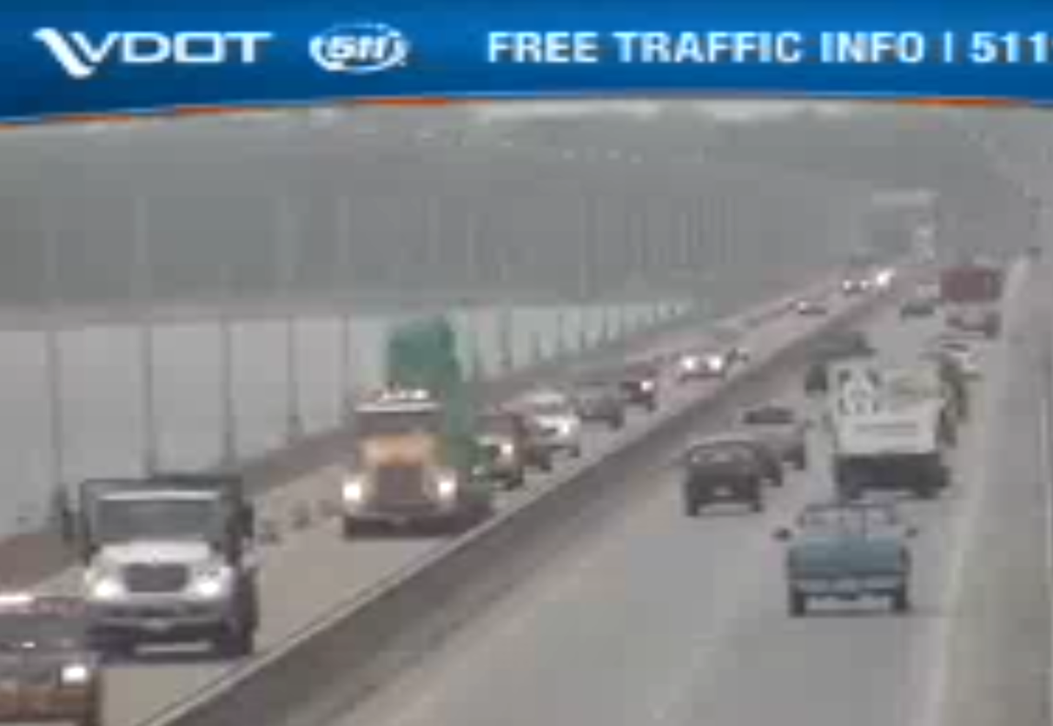
Q2 Coming over the James River Bridge
Neither rain nor snow nor dark of night….

Slide 6
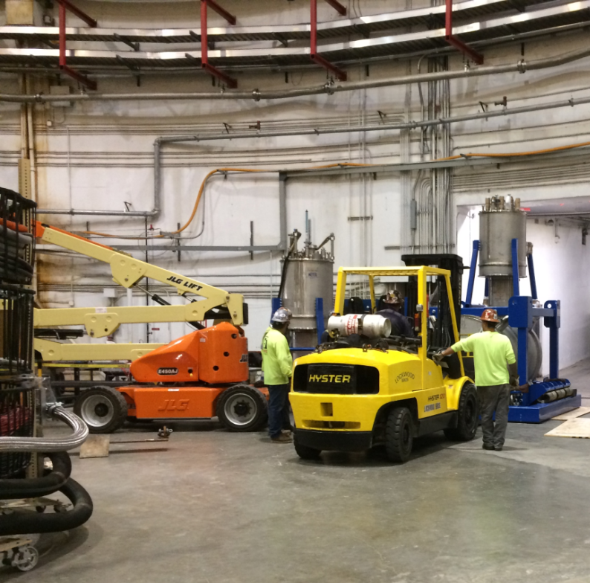
Q2 In Hall C October 7, 2016

Slide 7
Physics Division-Convened ERR for Q2/Q3/D
Oct 12, 2016
Charge: The committee is requested to assess if the design, fabrication, installation, protection systems and operational procedures of the SHMS HB Magnet satisfactorily support safe and efficient operation of the magnet within performance specifications.
Mechanical & cryogenics:
  pressure vessel ratings of each vessel in the magnet
  applicable codes & analysis
  material test/code documentation (if any)
  cryogenic circuit: supply, return, cooling procedures
  relief sizing to handle a quench or catastrophic loss of vacuum
  ODH analysis - worst credible release
  cryogenic controls
Power & magnet protection:
  quench analysis
  power lead ratings - flow requirements, voltage drop, etc.
  power supply characteristics/design
  magnet interlock & protection system(s)
  quantities monitored/expected thresholds/behavior logic
  failure mode and effect analysis/"what if" analysis
Magnet operation & documentation:
  instrumentation and controls
  drawings and schematics for the complete magnet system
  work rules/training requirements
  operation manual/procedures - integration with other magnets/systems
  identification of any special issue in the magnet system that requires special training and/or attention
Plan toward completion and resource loaded schedule for the three magnets
All Recommendations were addressed prior to proceeding with power testing of magnets.
ERR Committee
Joe Minervini (MIT)
Bob Flora (FNAL Ret)
Jonathan Creel (JLab)
Probir Ghosal (JLab)
Bob May (JLab)

Slide 8
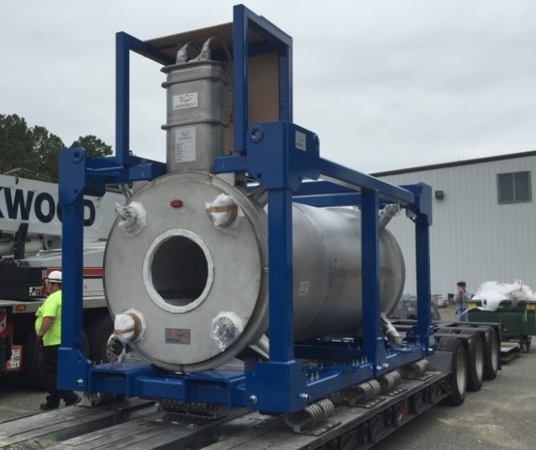
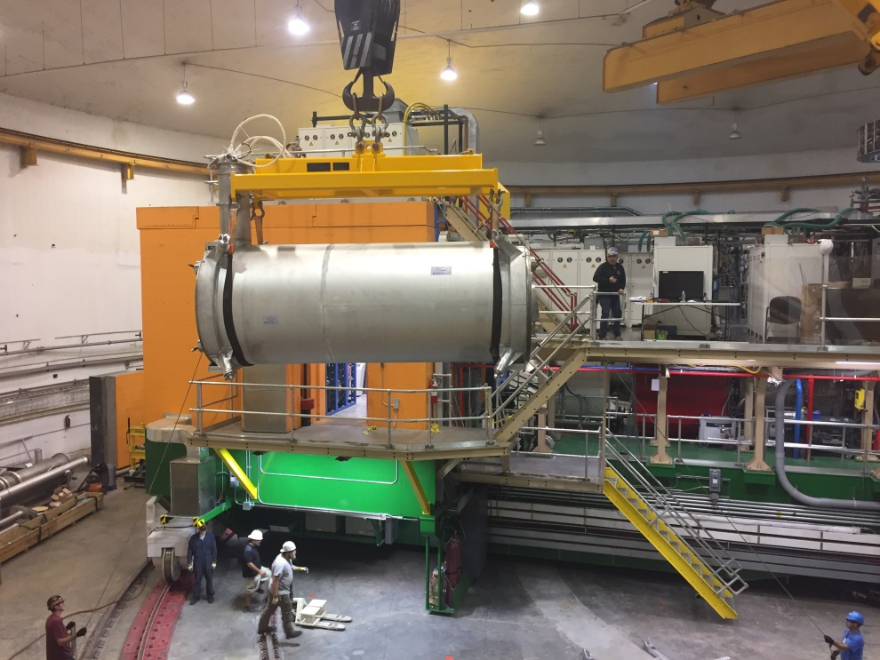
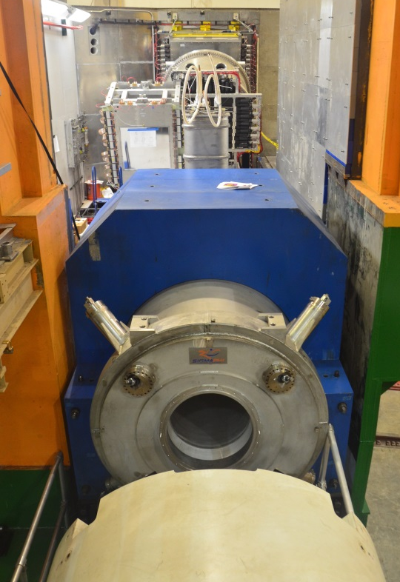
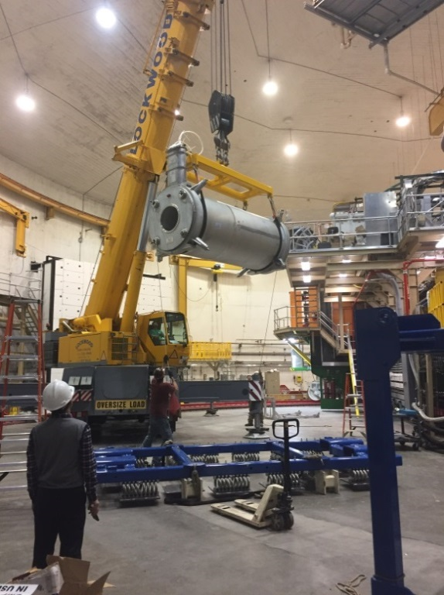
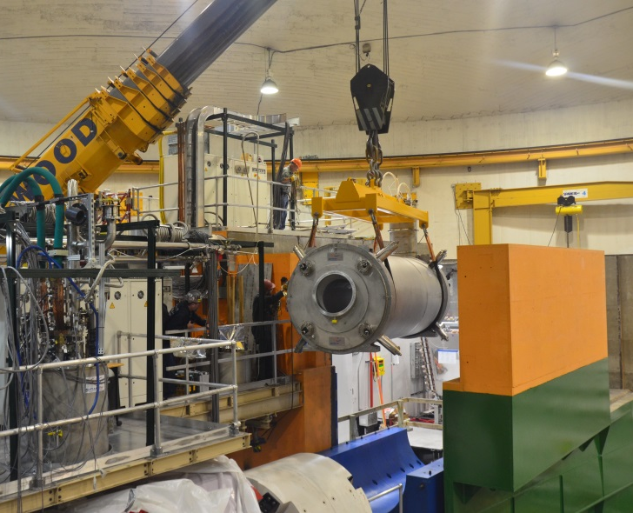
Dipole: Arrival and Installation
Nov 1, 2016
Nov 2, 2016
Nov 3, 2016

Slide 9
Magnet work at JLAB
Coil placed within lower yoke on SHMS
Upper yoke installed
Work platform installed for chimney assembly (unique to Dipole)
CCR mounted on top of SHMS detector hut (unique to Dipole)
Welding of CCR to dipole’s cryostat (unique to Dipole)
Leak/pressure tests
Hipot tests
Final I/C connections
Preparations for cool-down, then cool down
Power test
Quench detection optimization and magnet training
Magnetic field measurement

Slide 10
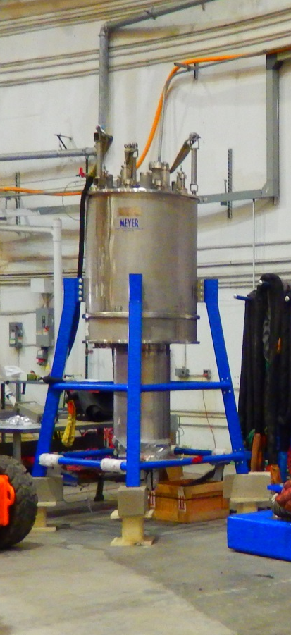
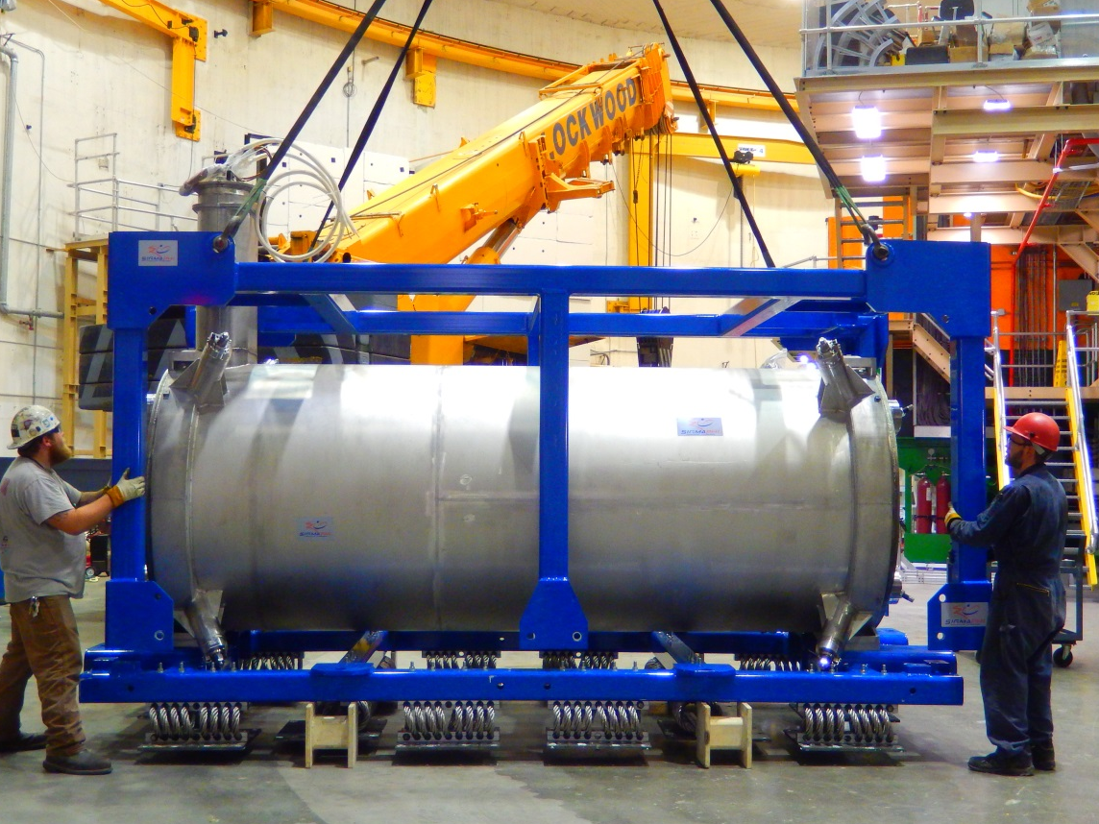
Dipole Pre-Installation
Dipole without its CCR
Dipole CCR can

Slide 11
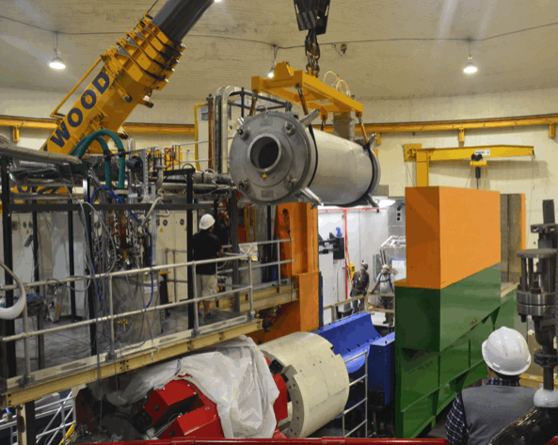
Dipole Installation (Nov 2016)

Slide 12
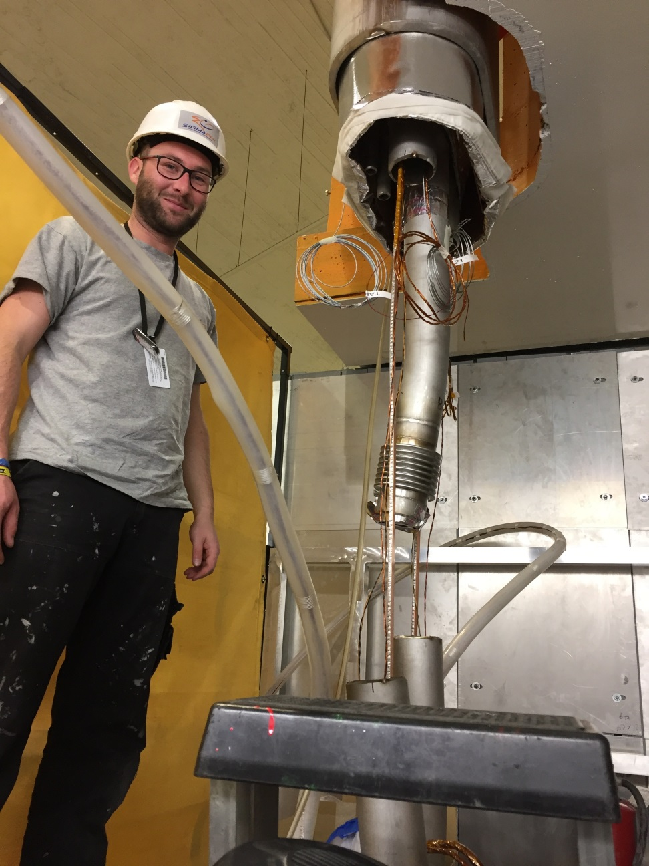
Dipole Current Leads Splicing (Nov 2016)

Slide 13
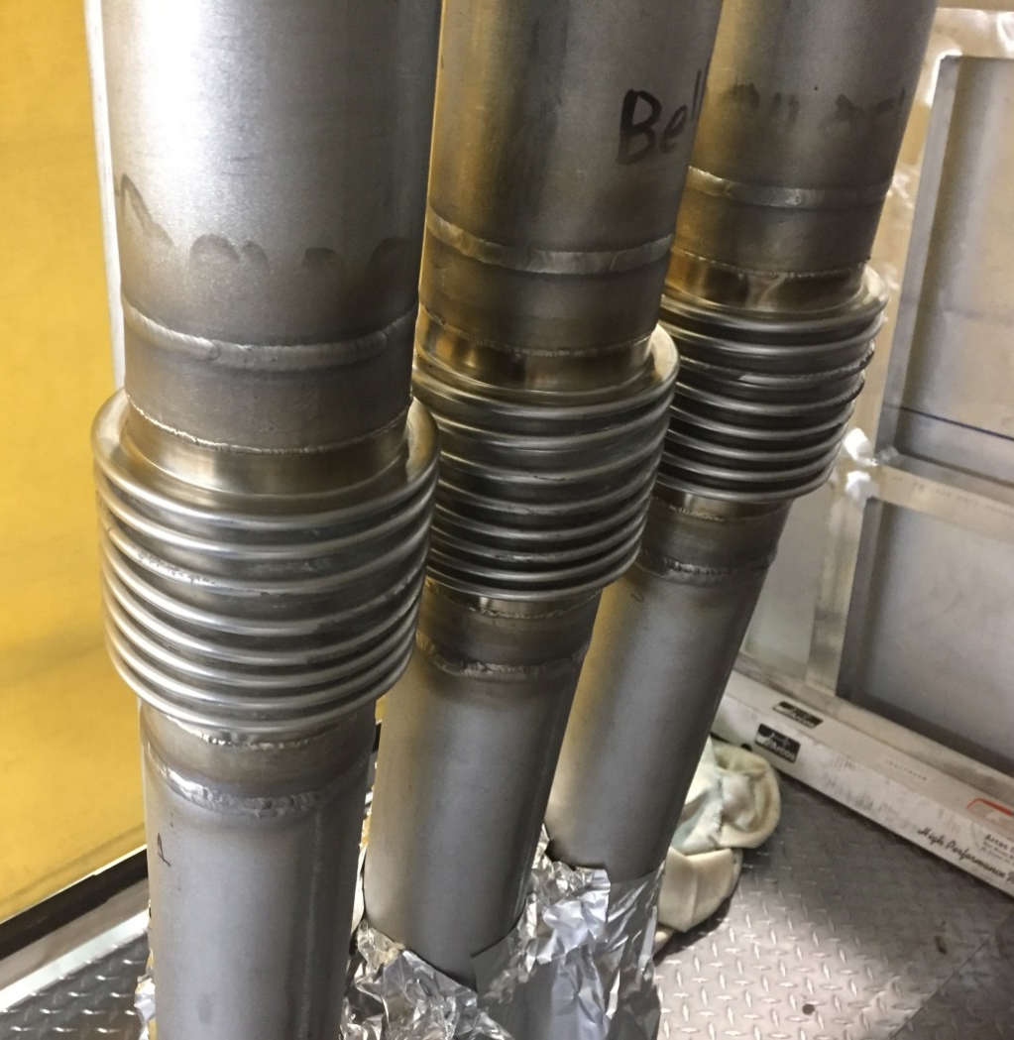
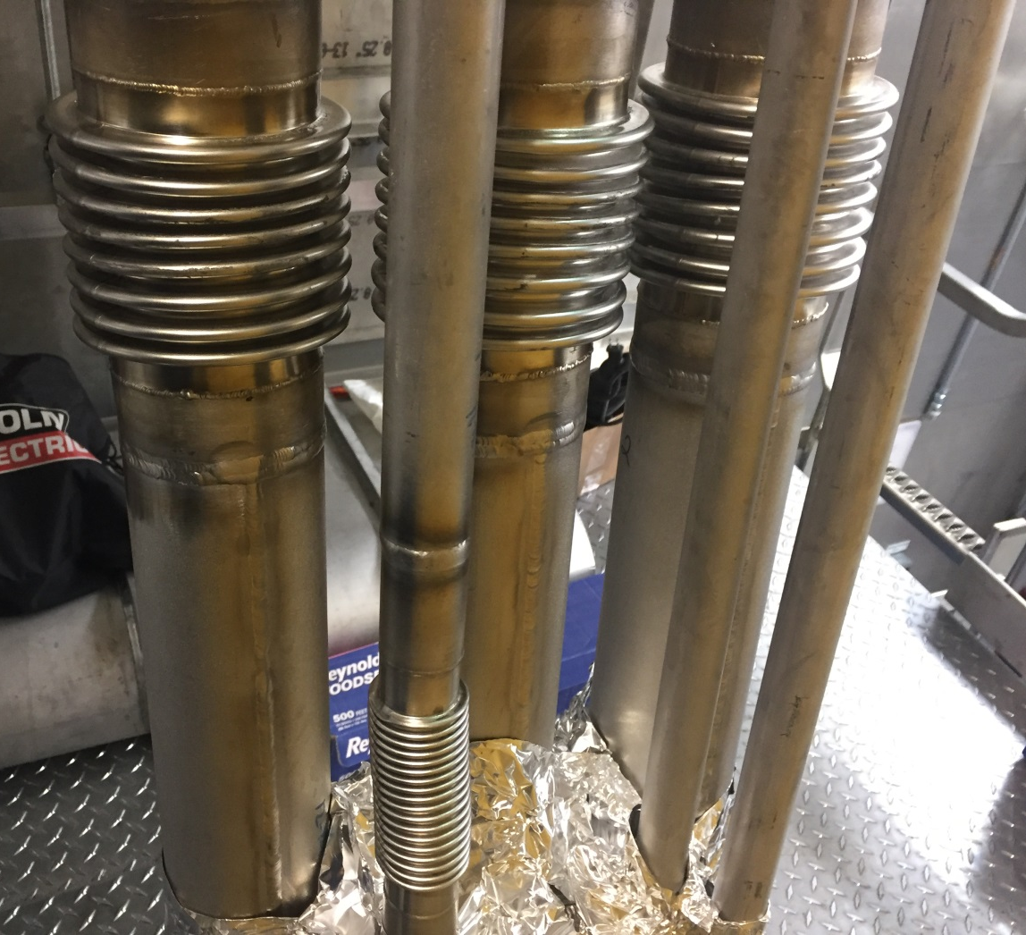
Dipole Cryo Lines Welded

Slide 14
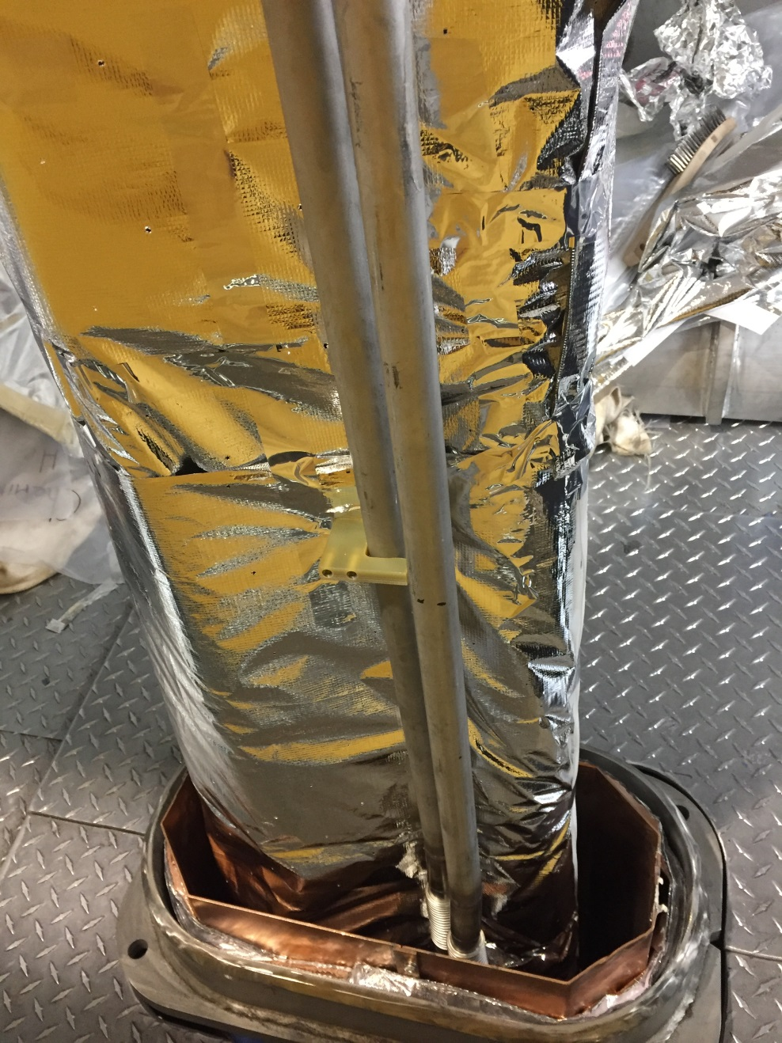
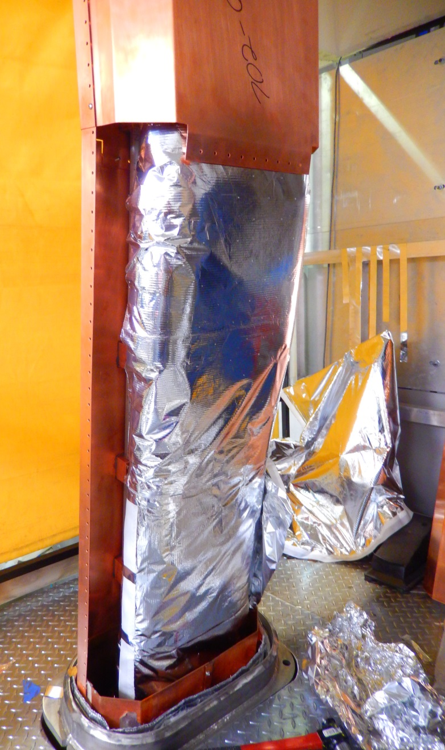
Dipole Chimney's MLI insulation and LN2 Shields

Slide 15
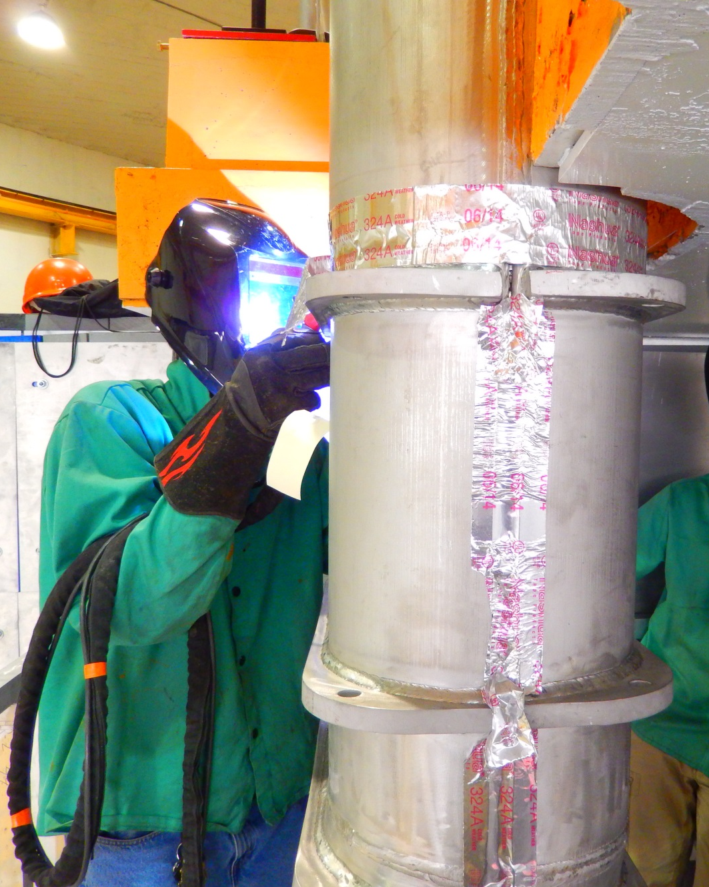
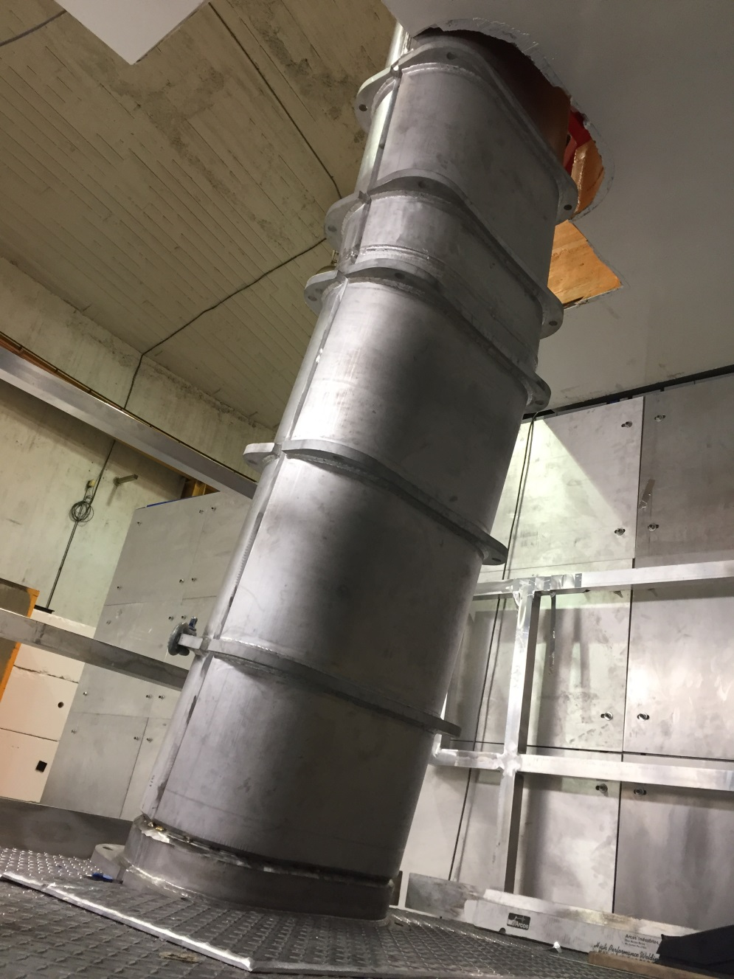
Dipole’s Chimney OVC Welding

Slide 16
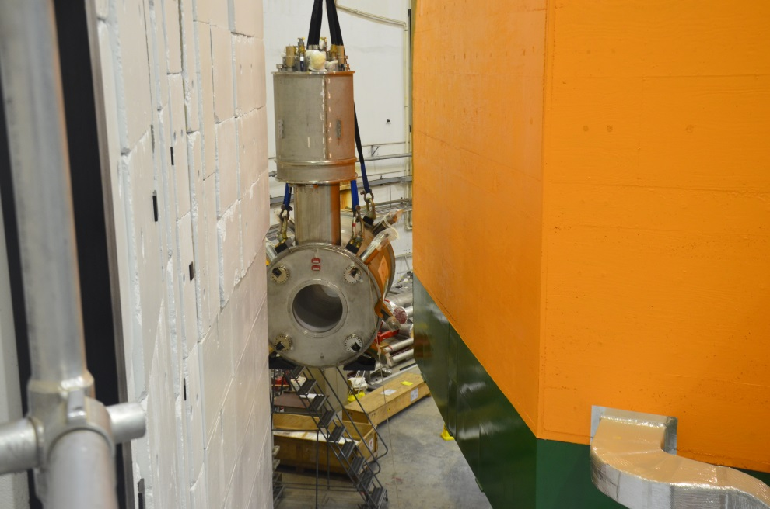
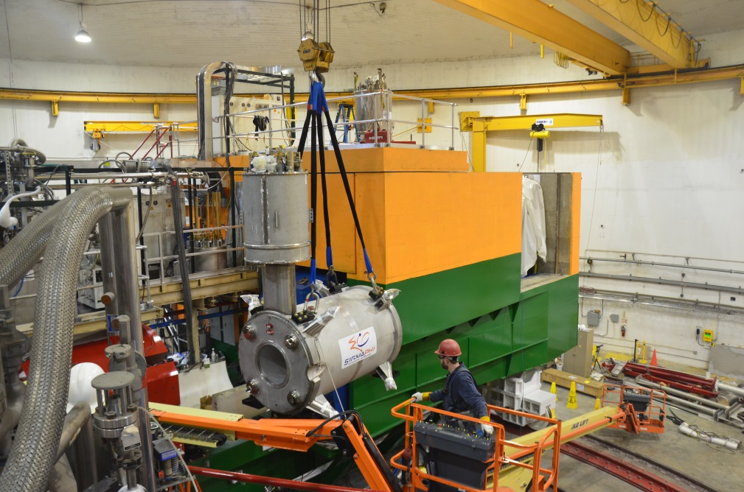
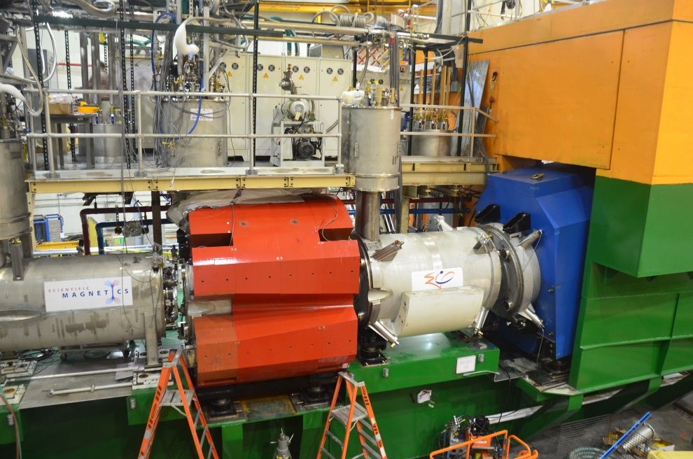
Q3 Installation (Dec 2016)

Slide 17
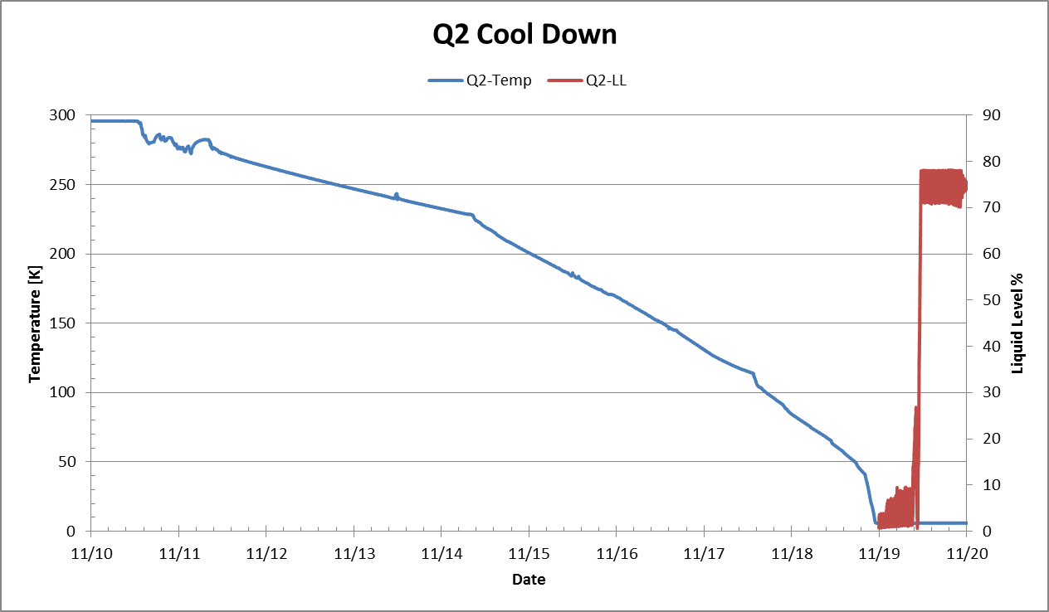
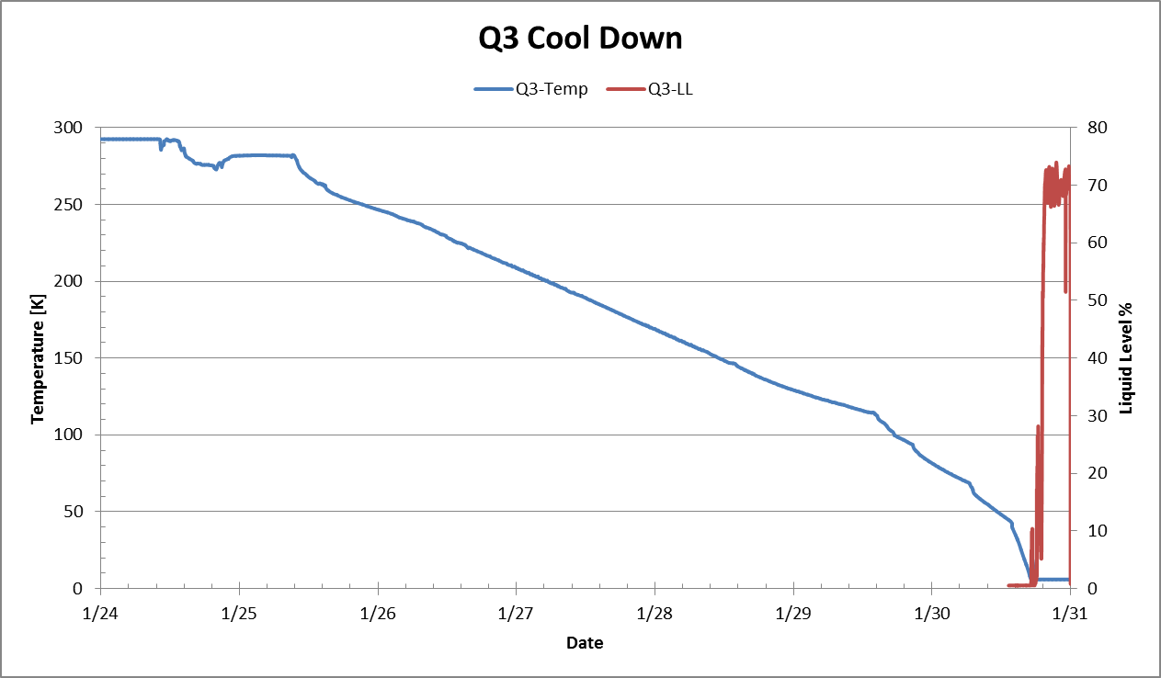
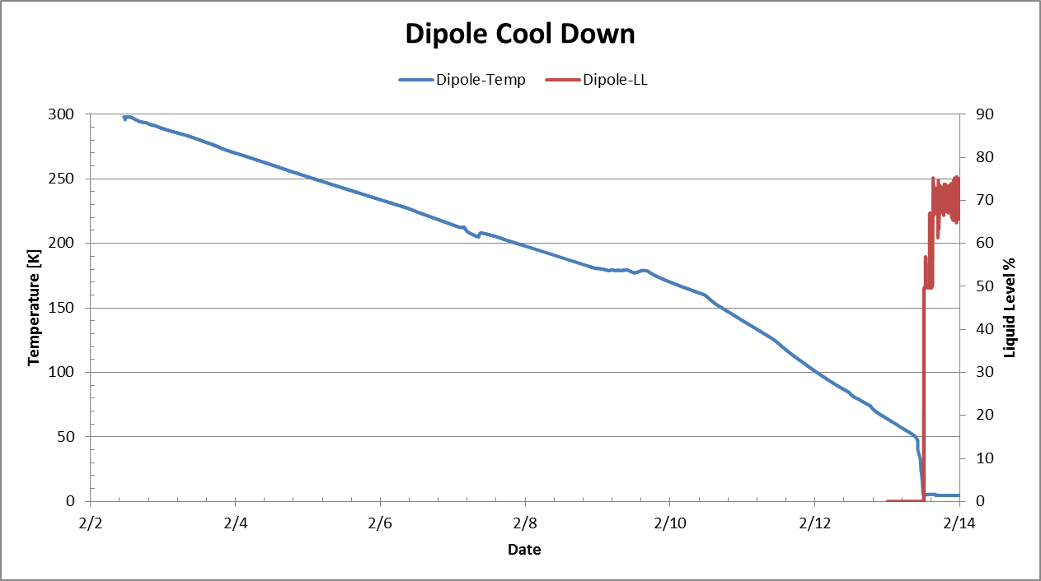
Magnet Cool-Down and Fill
All Quads cooled and filled faster than the 10 days expected.
Dipole faster than the 14 days expected. HB took 63 hours
Cool-down rate limited to 50K delta across magnet.
8.5 days
6.3 days
11 days
8 days

Slide 18
Magnet Testing Summary
Magnet | 11 GeV current | Max Current reached | # Quenches | Recover Time [min]
HB | 3930 | 4000 | 27 | 15*
Q1 | 2455 | 3000 | 0 | 30*
Q2 | 3660 | 3866 | 16 | 80
Q3 | 2480 | 3740 | 5 | 70
Dipole | 3450 | 3555 | 4 | 200
All magnets operated according to design !
* Unrestricted ESR cryogen

Slide 19
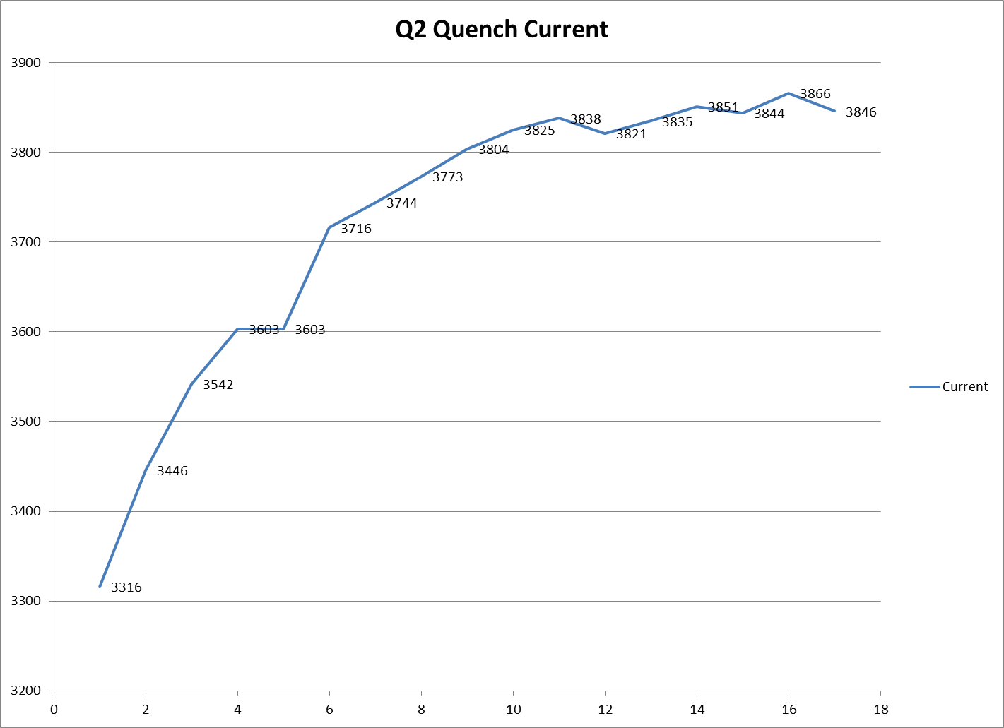
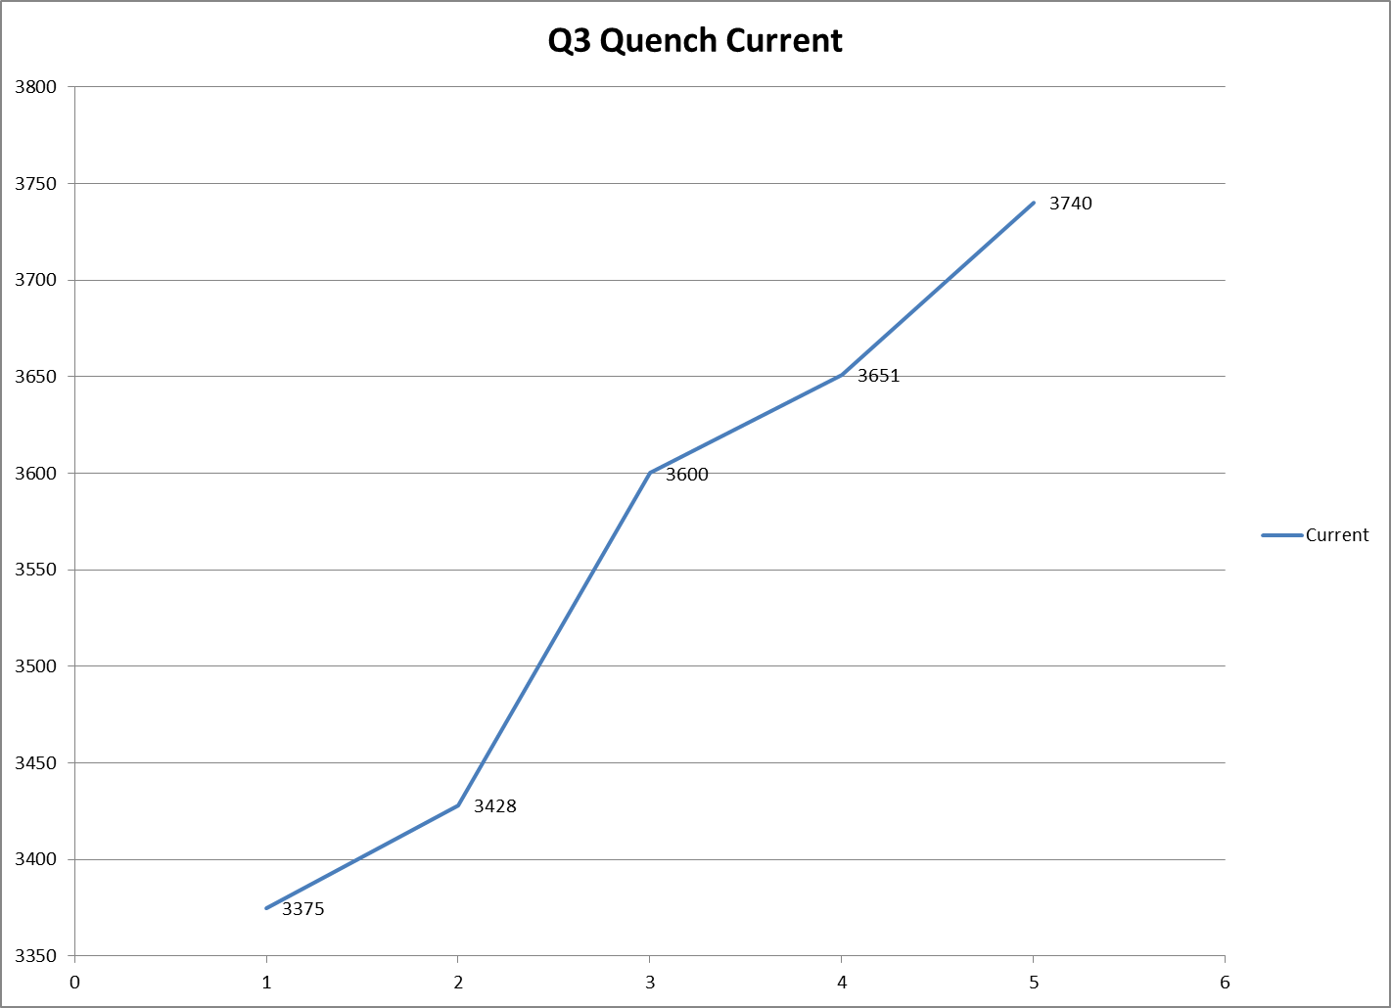
SHMS Quads Training Curve

Slide 20
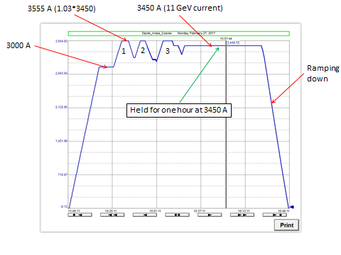
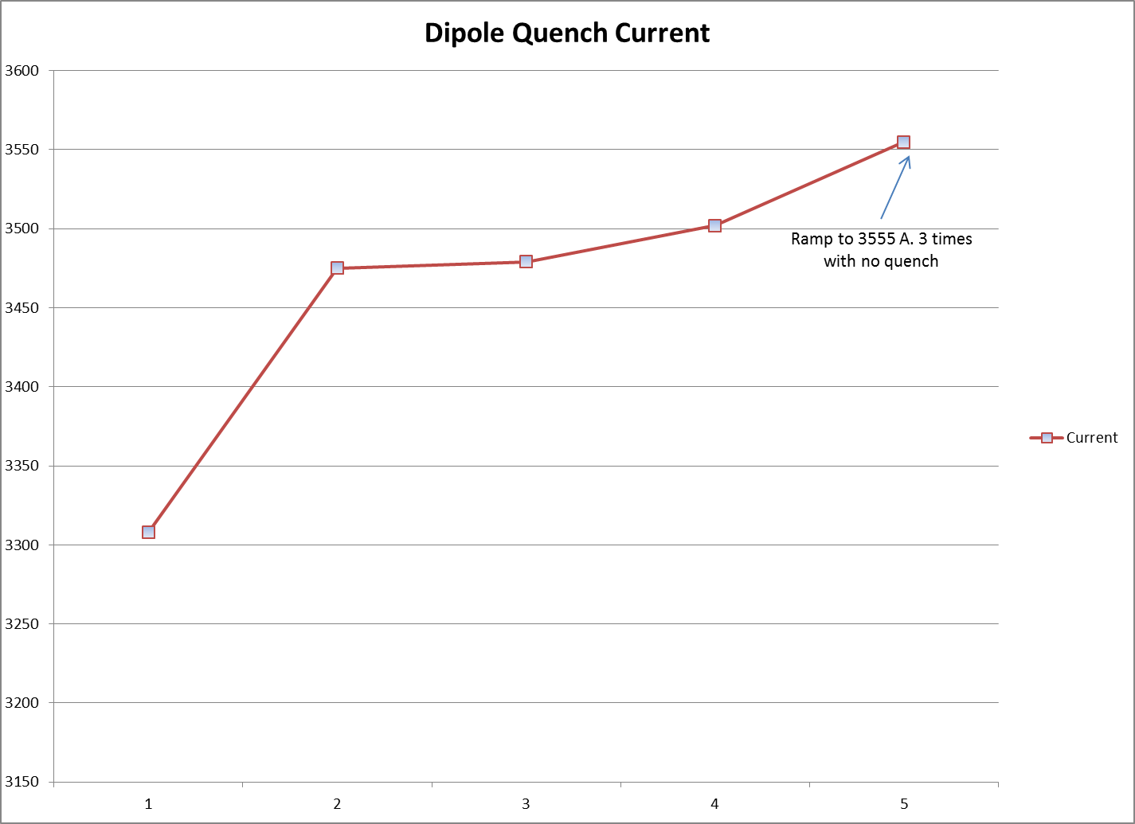
SHMS Dipole Training Curve
Dipole triple ramp to 3555. Demonstrated reliability.

Slide 21
Quench vs Non-Quench Initiated Fast Dump Characteristics
Helium Liquid levels were slightly different at onsite of events.
6% more liquid is Roughly 4kJ more latent energy available for cooling
Quench event level was 66% (21.0kJ deposited into magnet)
Fast dump level was 72% (16.8kJ deposited into magnet)
The behaviors of quench and fast dump are very similar.

Slide 22
Fast Dump induced Quench back effect Q3 (coil #2)
1125A
3500A
3500A
1500A

Slide 23
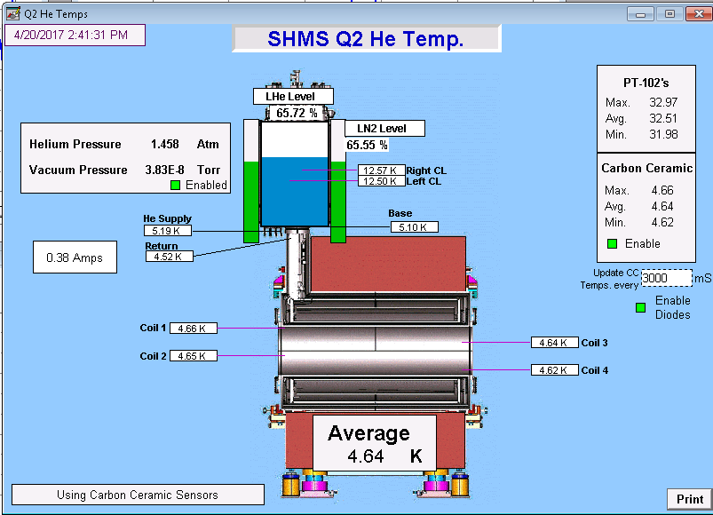
Magnets Operational
Control Screen

Slide 24
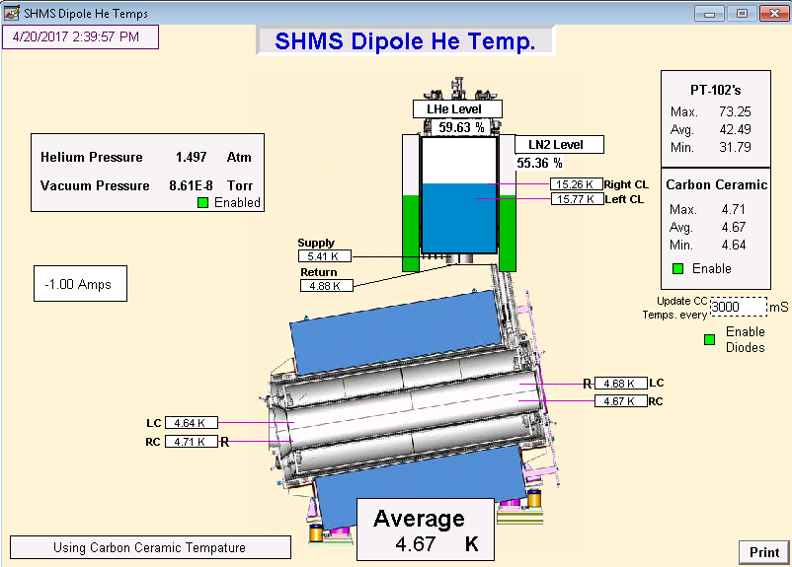
Dipole Controls Screen

Slide 25
Remaining “To Do” Work
SHMS
Magnetic field measurement and characterization.
Tune up quench detection settings. As low as possible.
Power Supply on/off spikes minimized.
Remote Rotation completion and check out.
Setup Polarity of magnets.
NMR field lock for Dipole.
Radiation Shielding HB and Dipole.
HMS
Dipole NMR probes (Spectrometer Support group)
PSU current calibrations (Spectrometer Support group)
PSU communication issues
Aged O-ring replacement

Slide 26
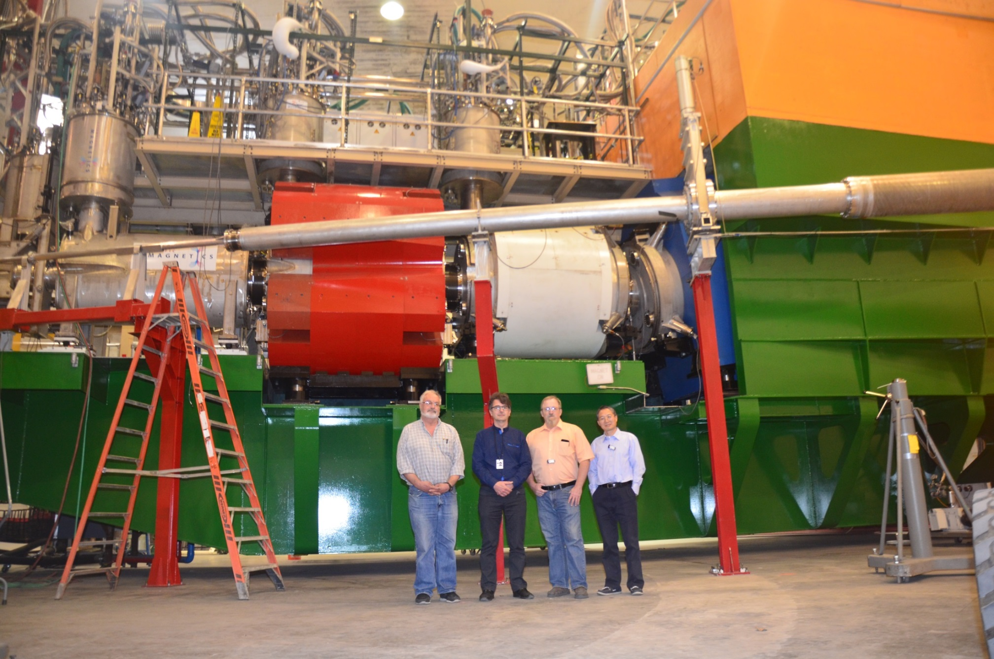
SHMS & HMS will be ready by Oct 1st

